Slide 1
JAVA COLLECTIONS
BY:
KAVYA AMPANI(Z1773728)
SRI VENKAT MANCHIKALAPUDI(Z1781696)

Slide 2
Collections
Collection represents a single unit of objects i.e. a group
java.util package contains all the classes and interfaces for Collection framework.
Insulate client programs from the implementation.
n array, linked list, hash table, balanced binary tree
Like C++'s Standard Template Library (STL)
Can grow as necessary.
Contain only Objects (reference types).
Heterogeneous.
Can be made thread safe (concurrent access).
Can be made not-modifiable.

Slide 3
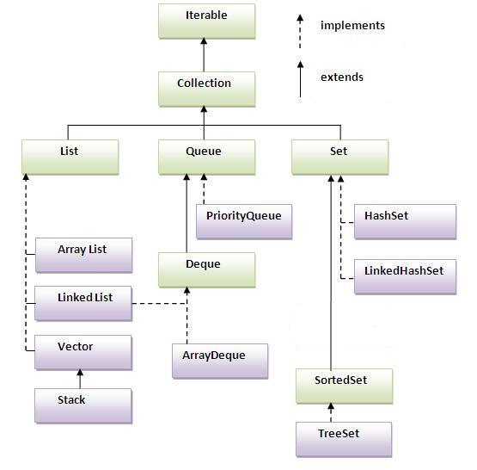

Slide 4
Collection Classes
Array list
Vector
HashSet
TreeSet
HashMap
Hashtable

Slide 5
Array
Most efficient way to hold references to objects.
Advantages
An array know the type it holds, i.e., compile-time type checking.
An array know its size, i.e., ask for the length.
An array can hold primitive types directly.
Disadvantages
An array can only hold one type of objects (including primitives).
Arrays are fixed size.

Slide 6
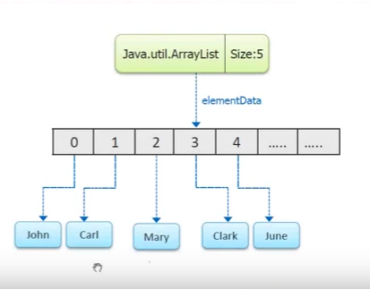
ArrayList
arrayList is the implementation of List interface
Array size is fixed but ArrayList size can grow dynamically.
ArrayList is used to store objects and perform
operations on it.
ArrayList is not Synchronized. Vector is similar to
ArrayList which is synchronized.

Slide 7
ArrayList
ArrayList is declared as:
ArrayList<Object to store>ArrayList object = new ArrayList<Object to store ();
The example program stores String objects.Prints all the objects of the ArrayList in new type of array.
Removes the string object by name and position ,displays the complete collection object.

Slide 8
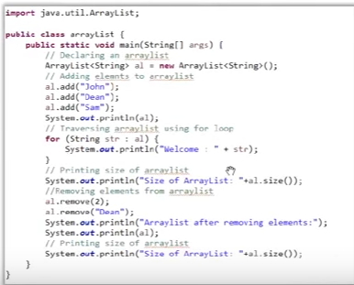
ArrayList Example:

Slide 9
vector
Vector is similar to ArrayList.
The only difference is that,vector is synchronized but ArrayList is not
That means Vector is ThreadSafe

Slide 10
Vector Example:
Import java.util.Vector;
Public class arrayList {
public static void main(String[] args) {
//Declaring a vector
Vector<Integer> v = new Vector<Integer>(3,2);
//Adding elements to vector
v.add(10);
v.add(20);
System.out.println(v.size());
}
}

Slide 11
Queue
Queue
PriorityQueue is a class which implements Queue interface and sorts the data stored.
DeQue stands for double ended queue.
The queue can be operated at both the ends. Same holds for Insertion and deletion too.
Queue operates on the principle of “first in first out”.

Slide 12
Program on PriorityQueue
import java.util.PriorityQueue;
public class priorityQueue {
public static void main(String[] args) {
PriorityQueue<Integer> pq= new PriorityQueue<Integer>();
for (int i=10; i>0; i--) {
pq.add(new Integer(i));
}
for(int i = 1; i <= 10; i++) {
Integer c = pq.poll();
System.out.println©;
}
}
}

Slide 13
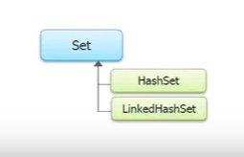
Set
A set is a collection interface. HashSet and Tree set are implemented from Set.
Set cannot have duplicates.
Class HashSet removes the duplicates and gives better performance over TreeSet. It doesn’t guarantee to store the data in the same order it is inserted.
Class TreeSet sorts the added data apart from removing the duplicates.

Slide 14
TreeSet
Import java.util.TreeSet;
public class priorityQueue {
public static void main(String[] args) {
TReeSet<String> ts = new TreeSet<String>();
ts.add(‘’ram”);
ts.add(“ram”);
ts.add(“ sarah”);
ts.add(“angel”);
System.out.println(ts);
}
}
This program add names,sorts then and displays the names using TreeSet. ram is added twice in collection but when printed ram will be displayed only once as the second is removed as duplicate by treeSet.

Slide 15
HashSet
import java.util.HashSet;
import java.util.Iterator;
public class priorityQueue {
public static void main(string[] args) {
HashSet <Integer> hs = new HashSet<Integer>();
hs.add(1);
hs.add(2);
hs.add(3);
Iterator<Integer> it = hs.iterator();
while (it.hasNext()) {
int i= (integer) it.next();
System.out.println(i);
}
}
}

Slide 16
HashMap
The HashMap class uses a hashtable to implement the Map interface. This allows the execution time of basic operations, such as get( ) and put( ), to remain constant even for large sets.
A HashMap contains values based on the key. It implements the Map interface and extends AbstractMap class.
It contains only unique elements.
It may have one null key and multiple null values.
It maintains no order.

Slide 17
HashMap
import java.util.*;
class TestCollection13{
public static void main(String args[]){
HashMap<Integer,String> hm=new HashMap<Integer,String>();
hm.put(100,"Amit");
hm.put(101,"Vijay");
hm.put(102,"Rahul");
for(Map.Entry m:hm.entrySet()){
System.out.println(m.getKey()+" "+m.getValue());
}
}
}

Slide 18
Collection Advantages and Disadvantages
Advantages
Can hold different types of objects.
Resizable
Disadvantages
Must cast to correct type
Cannot do compile-time type checking.

Slide 19
THANK YOU!

